Slide 1
COMPUTER PROGRAMMING IN C
UNIT - 1
SESSION - 5

Slide 2
TYPES
A type defines a set of values and a set of operations that can be applied on those values.
A programming language is proposed to help programmer to process certain kinds of data and to provide useful output.
The task of data processing is accomplished by executing series of commands called program.
A program usually contains different types of data types (integer, float, character etc.) and need to store the values being used in the program.
C language is rich of data types.

Slide 3
Data types
Data types can be broadly classified into 3 types :
Primary Data Type (Fundamental Data Types)
Derived Data Type
User Defined Data Type

Slide 4
Primary Data Type (Fundamental Data Types or Primitive) :
All C compiler support five types of fundamental data types:
1. Integer (int) = 2,768 to 32,768
2. Character (char) = -128 to 127
3. Floating Point (float) = 3.4e-38 to 3.4e+38
4. Double Precision Floating Point (double) = 1.7e-308 to 1.7e+308
5. Void Data Type (void) (It is used for function when no value is to
be return)

Slide 5
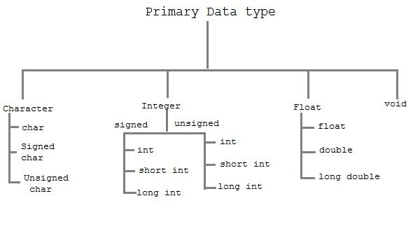

Slide 6
Primary Data Type (Fundamental Data Types or Primitive) :
The most fundamental data types that every C compiler supports are: int, char, float and double.
Other compilers support the extended versions of these fundamental data types like: short int, long int, long double etc.
The signed data types are used for storing both positive and negative values whereas the unsigned data types are used to store only positive values.
The memory capacity of these data types are based on the hardware.

Slide 7
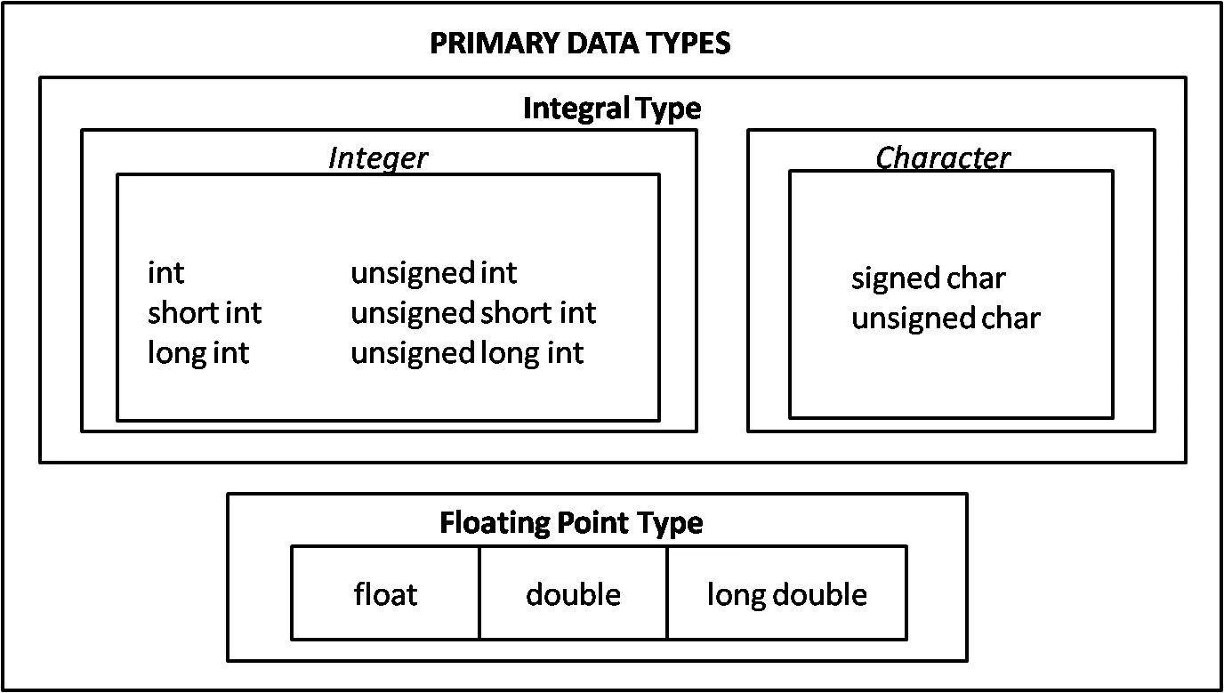

Slide 8
Primary Data Type (Fundamental Data Types or Primitive) :
Integer type : integers are used to store whole numbers.
Floating type : Floating types are used to store real numbers.
Character type : Character types are used to store characters value. Internally it is stored as integer. Each character has its own ASCII values. (American Standard Code for Information Interchange).
A to Z = 65 to 90 and a to z = 97 to 122
void type : void type means no value. This is usually used to specify the type of functions.

Slide 9
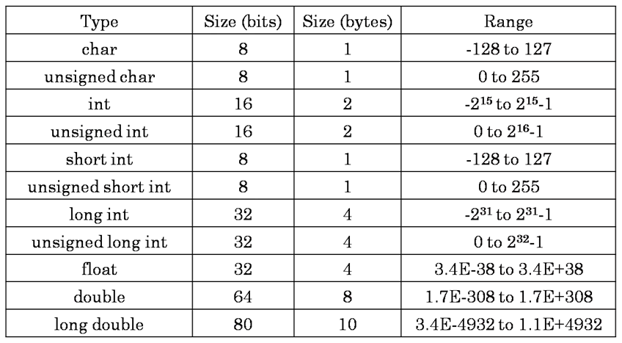
Following tables shows the Size and Range of Data Types on a 16-bit Machine:

Slide 10
2. User defined Data type :
By using a feature known as "type definition" that allows user to define an identifier that would represent a data type using an existing data type.
We can create user-defined data types in two ways:
1) By using the “typedef” keyword - The “typedef” keyword can be used to
declare an identifier as a user-defined data type.
2) By using the “enum” keyword - The “enum” is used to declare identifiers
as user-defined data types. Such data types are also called as
enumerations.
Advantage :
1. Main advantage of typedef is that we can create meaningful data type
names for increasing the readability of the program.

Slide 11
3. Derived Data Type :
Those data types which are derived from fundamental data types are called derived data types.
There are basically three derived data types .
1. Array: A finite collection of data of same types or homogenous
data type.
2. String: An array of character type.
3. Structure: A collection of related variables of the same or
different or heterogeneous data types.

Slide 12
VARIABLES
When we want to store any information, we store it in an address of the computer.
Instead of remembering the complex address where we have stored our information, we name that address. The naming of an address is known as variable.
Variable is the name of memory location.
Unlike constant, variables are changeable, we can change value of a variable during execution of a program.
A programmer can choose a meaningful variable name.
Example : average, height, age, total etc.

Slide 13
Rules to define variable name:
Variable name must not start with a digit.
Variable name can consist of alphabets, digits and special symbols like underscore _.
Blank or spaces are not allowed in variable name.
Keywords are not allowed as variable name.

Slide 14
VARIABLES
VARIABLE DECLARATION
VARIABLE INITIALIZATION

Slide 15
VARIABLE DECLARATION
Declaration of variables must be done before they are used in the program.
Declaration does two things :
It tells the compiler what the variable name is.
It specifies what type of data the variable will hold.
VARIABLE INITIALIZATION
Definition of variable or initialization of a variable means to assign a value to a variable.
Definition specify what code or data the variable describes. A variable must be declared before it can be defined.

Slide 16
Example Program :
#include<stdio.h> #include<conio.h> void main() { int a,b,sum; //variable declaration a=10; //variable definition b=20; //variable definition sum=a+b; printf("Sum is %d",sum); getch(); }
Output:
Sum is 30

